Slide 1
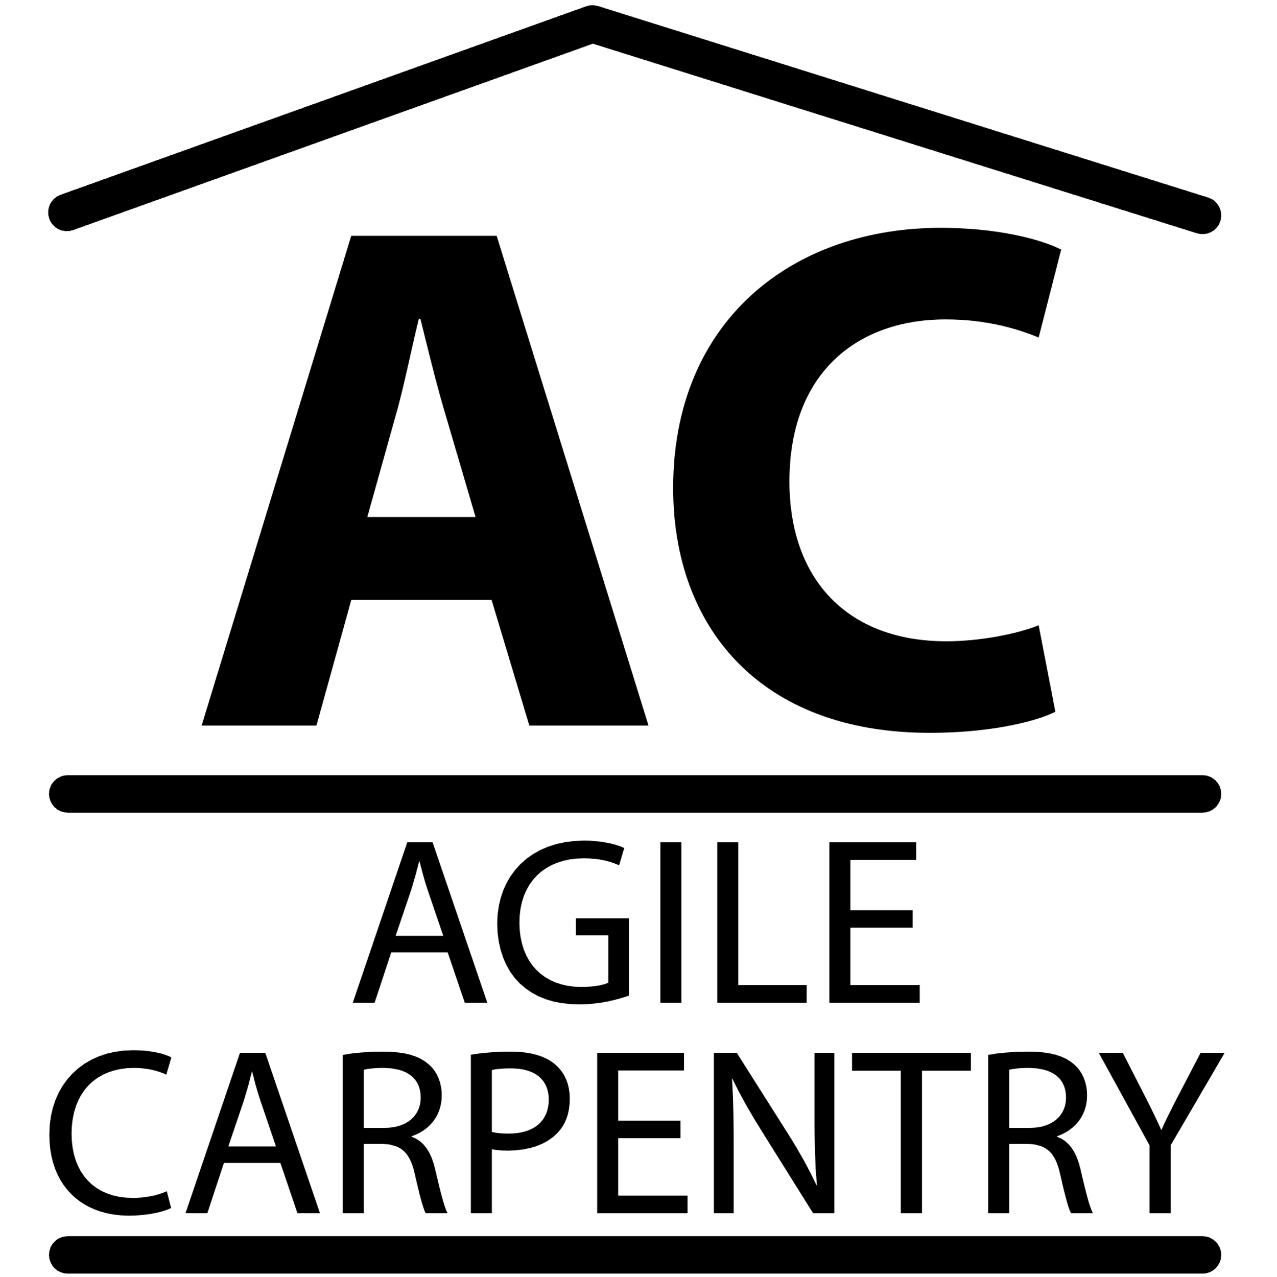
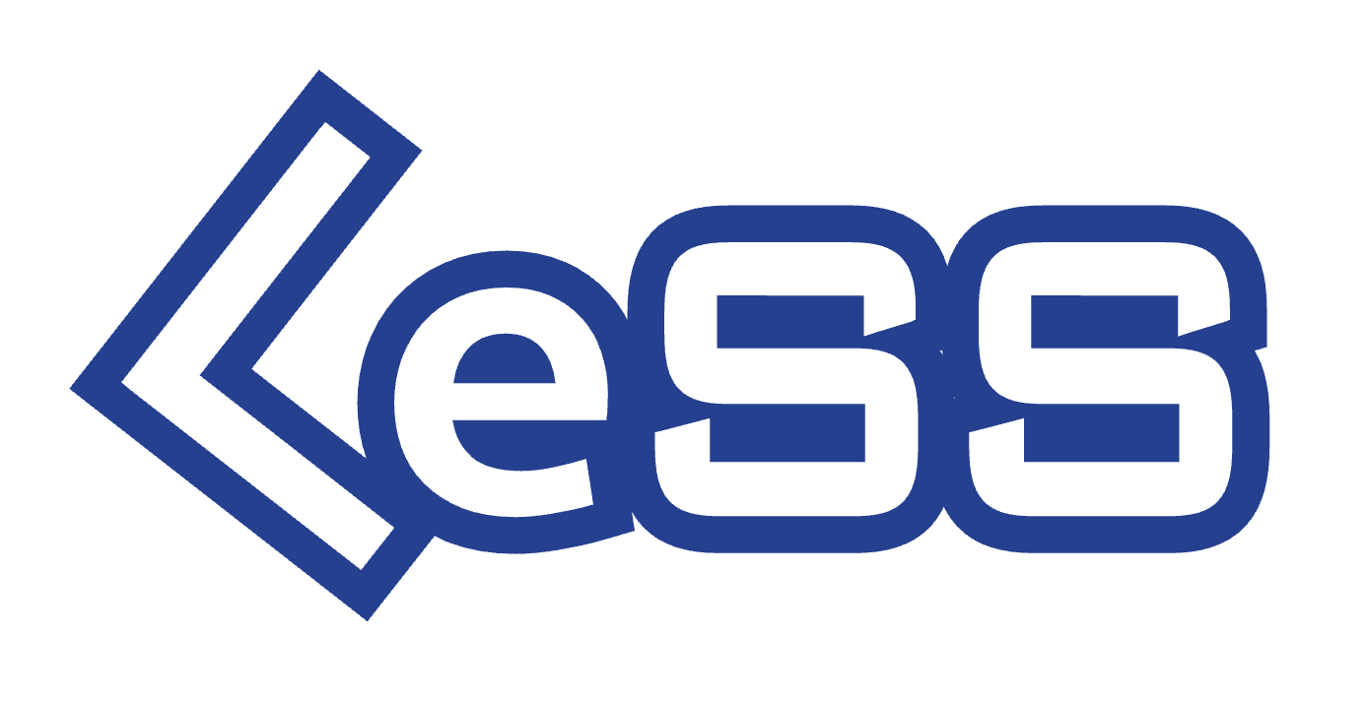

Slide 2
Why
LeSS?

Slide 3
Why
?
Greater
Revenue
Greater
Adaptiveness
Greater Customer Value
Greater Revenue
=>
=>

Slide 4
Why
?
Achieving
Adaptiveness
LeSS is an organizational system for product development aimed at maximizing an organization’s adaptiveness. With adaptiveness (or agility, the original intent of agile development) we mean optimizing towards:
Ability to change direction with relatively low cost, primarily based on discovery through frequent delivery, for…
Maximizing value delivered to customers and end-users.
LeSS is the result of two decades of Go See, systems thinking, and experimenting to achieve organizational adaptiveness.

Slide 5
Why
?
Systems
Approach
Many companies are keen to adopt the latest ‘agile’ process as long as it doesn’t result in much change. It must be safe. But typically minimal change brings minimal benefit.
LeSS takes a systems approach to organizations. An organization is at least the sum of the people, customers, structure, policies, processes, and practices, plus their interaction effects… and to achieve adaptiveness, cheap and easy change, these are all likely to be impacted, changed and aligned. Only focusing on adopting a mere process framework and likewise on just local team agility, will not achieve systemic organizational adaptiveness.

Slide 6
Why
?
Simpler
Structures
Some key barriers to adaptiveness are organizational complexity and too much single specialization. To achieve adaptiveness organizations cannot simply “add agility” to their existing processes and roles. They have to rethink how the organization works in a simpler and more flexible way.
The More with LeSS principle recognizes that innumerable roles (especially over-specialized roles), complex processes, and over-abundant artifacts will lead to inflexible and slow organizations… even when called ‘agile’. Some structure is of course needed but myriad formal processes, roles, and artifacts are costly and anti-adaptive and therefore to be avoided. This simplification can be achieved by following the seven organizational design principles that expand the More with LeSS principle.

Slide 7
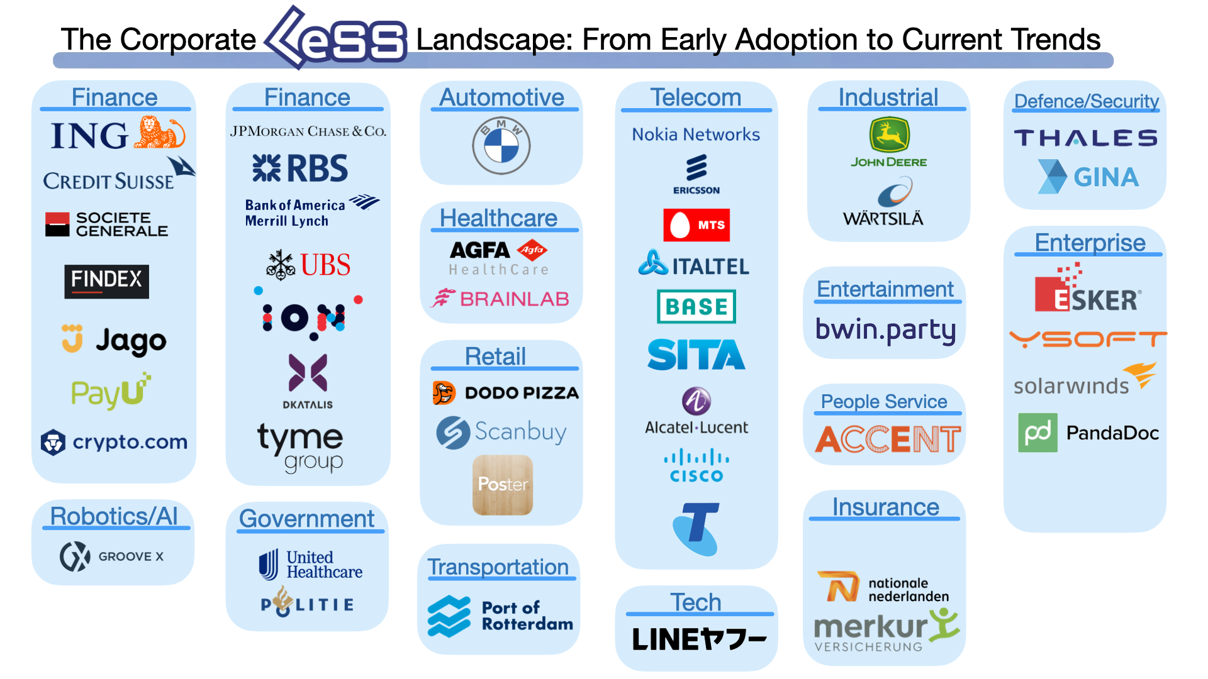
Don’t Be
Left Behind
Why
?

Slide 8
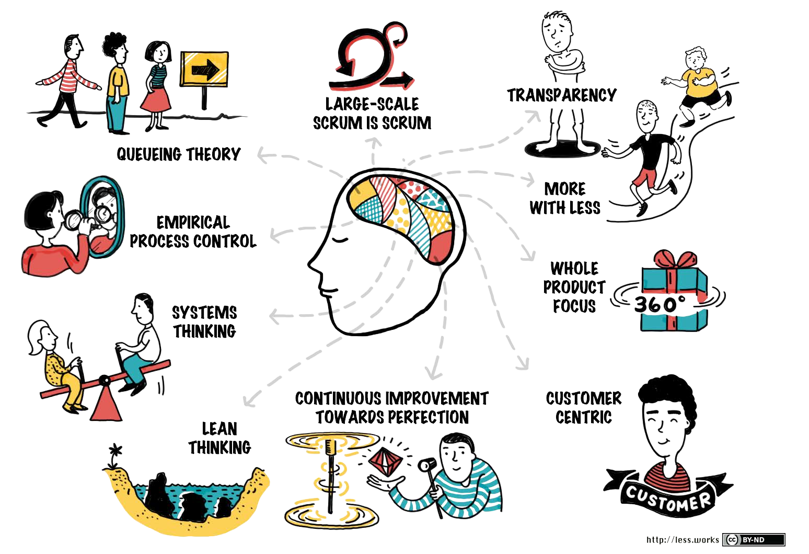
Why
?
LeSS
Principles

Slide 9
Why
Agile Carpentry?

Slide 10
Why
?
Superior
Vetting
The mentorship program and vetting process for LeSS trainers is exceptionally rigorous. The LeSS case study authorship, editorial review, and mentorship process ensures every LeSS trainer has deep real-world experience creating meaningful organizational change. The process is analogous to a doctorial thesis process in the applied sciences.
There are currently 28 Certified LeSS Trainers (CLTs) globally.
James Carpenter is one of only 4 CLTs in the United States.

Slide 11
Why
?
Experience
In a little over a year at a large networking and server hardware company James Carpenter’s leadership was responsible for the following:
Mitigating the perpetual existential threat to one billion in annual revenue by adopting a LeSS-like structure within the BIOS firmware teams.
Establishing a cross-functional, cross-component, self-managing team which quickly saved the organization hundreds of millions in reduced warranty costs.
Success in each case was achieved by addressing underlying structural issues hindering earlier efforts.
You can read about the above effort in his LeSS case study at:
https://less.works/case-studies/large-server-hardware-company

Slide 12

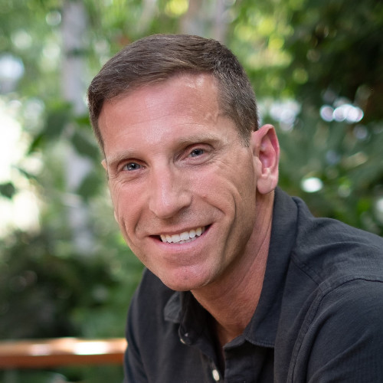
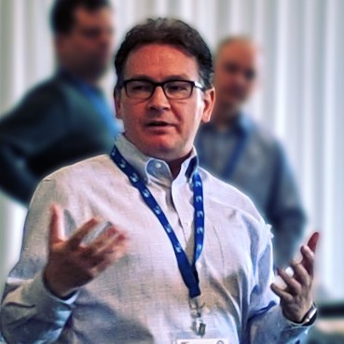
Why
?
Written
Recomendations
Working with James was a transformational experience for me, and for the team. He took us from “No Way Scrum Can Be Done Here” to “We Can’t Ever Go Back.
– Dmitry Barsky
He is not only fluent in Agile methodologies but is extremely well versed in software development methodologies – which allows him to go toe to toe with some of the most technically astute developers and senior leaders in the organization.
– Trevor Gamba
If you are looking for an agile coach who will tell you what you need to hear, James is an excellent one to reach out to.
– David Stackleather

Slide 13

Why
?
Global
Logistics
Agile Carpentry has the global logistical capability to alleviate the client burden required to host a systems modeling based LeSS course.
This is more unique than you might expect.

Slide 14
Why Sponsor A
Systems Modeling Based LeSS Course?

Slide 15
Why
?
Systems Modeling
Based Workshop
Telling people why and how they should change doesn’t usually work. Letting them figure it out for themselves often does.
Agile Carpentry’s 3-Day Certified LeSS Practitioner course, and related Certified LeSS for Executives course is built around a systems modeling workshop. Participants spend much of their time in small groups at large whiteboards thoughtfully mapping out how various organizational design choices influence outcomes.
Between modeling sessions, participants map the new theoretical insights they are teaching themselves into the actionable approaches found in LeSS.
Throughout the experience, James provides guidance, facilitates discussions, shares his own expert insights, and provides brief lectures between exercises.

Slide 16
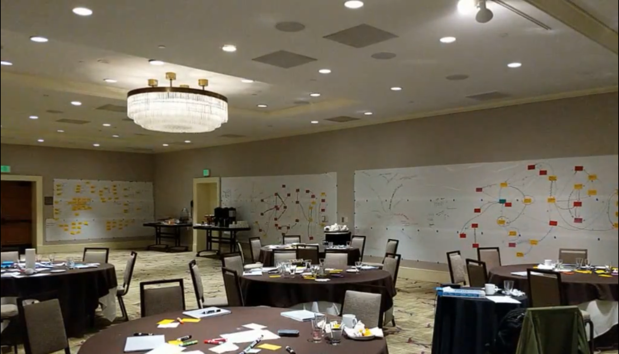
Why
?
Systems Modeling
Based Workshop
Participants convince themselves of the need to change the organizational design.

Slide 17
Why
?
LeSS Practitioner
or LeSS for Exec.
The initial 3-days of systems modeling-based knowledge transfer is roughly the same in both the Certified LeSS Practitioner and the Certified LeSS for Executives workshop.
The primary change with a Certified LeSS for Executives is a more carefully curated attendee mix, along with additional facilitated discussion to achieve executive alignment on a path forward.
A successful Certified LeSS for Executives requires a careful mix of people with sufficient structural authority, and more senior individual contributors who can bring ground truth to the discussions.
You can learn more here: https://agilecarpentry.com/cle/global/

Slide 18
Why
?
Executive Buy-In
Required
“Every system is perfectly designed to get the results it gets.”
— Dr. Edward Deming
Achieving greater adaptability and value delivery requires deep organizational change. You can’t do this without executive buy-in.
Achieving executive buy-in requires executives to develop their own insights into how various organizational design decisions impact organizational adaptability.
Once there is a common shared understanding, it becomes possible to create a common shared vision of what changes should be undertaken. Agile Carpentry can help put those changes in place, but only if the executive buy-in to do so exists.

Slide 19
Services
Available

Slide 20
Services
Available
An in-person Certified LeSS for Executives or Certified LeSS Practitioner course is the best approach for establishing an initial relationship and on-going dialogue. This helps to establish trust, understanding, and alignment. The natural next step is to stand-up a few initial teams in a LeSS structure.
To help with this, the following services are available on a global basis:
Stand-alone training
Certified LeSS Practitioner
Certified LeSS for Executives
Training and launching teams
Long-term coaching
Cadenced in-person trips every few Sprints
Remote advisory services

Slide 21
Contact
Details
James Carpenter
Certified LeSS Trainer
Agile Carpentry
Milwaukee, WI, U.S.A.
+1 832-677-7247
james@agilecarpentry.com
https://agilecarpentry.com/

